Slide 1
MEMORY MANAGEMENT
PRINCIPLES OF COMPUTER SYSTEMS

Slide 2

WHAT IS MEMORY?
Memory is used to store data, information and instructions that the computer's processor (CPU) can access quickly.
Memory is classified into two types :
Primary Memory (RAM)
Secondary Memory

Slide 3

PRIMARY MEMORY REQUIREMENTS
Access Time : It should be as small as possible.
Size : Size must be as large as possible.
Cost : Cost of the memory should be less than the cost of the computer.

Slide 4
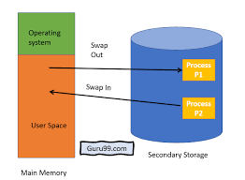
MEMORY MANAGEMENT
In a multiprogramming computer, the Operating System resides in a part of memory, and the rest is used by multiple processes. The task of subdividing the memory among different processes is called Memory Management.

Slide 5
MEMORY MANAGEMENT REQUIREMENTS
WHY DO WE NEED TO MANAGE OUR MEMORY ?
Allocate and de-allocate memory before and after process execution.
To keep track of used memory space by processes.
To proper utilization of main memory.
Minimize access time.

Slide 6
MEMORY PARTITIONING
Memory partitioning, also known as memory segmentation or memory management, is a technique used in computer operating systems to divide the computer's memory into multiple partitions or segments. These partitions allow the operating system to allocate memory efficiently to different processes and applications running on the system.
Memory partitioning is classified into two types :
1. Fixed (or) Static Partitioning
2. Dynamic (or) Variable partitioning

Slide 7
FIXED PARTITIONING
Fixed partitioning, also known as static partitioning, is a memory allocation technique used in operating systems to divide the physical memory into fixed-size partitions or regions, each assigned to a specific process or user.
In fixed partitioning, the memory is divided into fixed-size chunks, with each chunk being reserved for a specific process. When a process requests memory, the operating system assigns it to the appropriate partition. Each partition is of the same size, and the memory allocation is done at system boot time.
Some advantages of fixed partitioning includes
Easy and simple to implement
Minimum amount of memory is required
Prevents the process from interfering with other memory

Slide 8
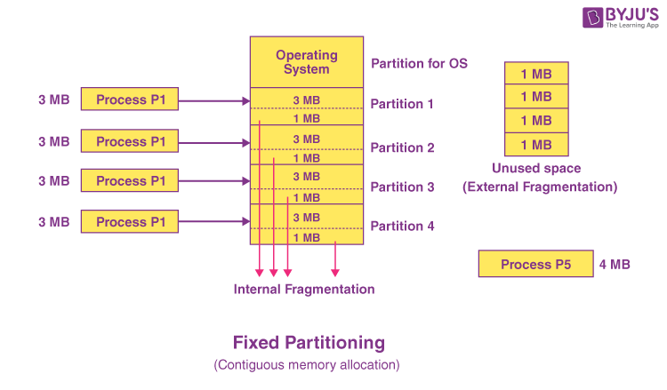

Slide 9
FRAGMENTATION
INTERNAL AND EXTERNAL FRAGMENTATION
Internal fragmentation occurs when allocated memory is larger than what is actually needed by the process. In other words, the allocated memory contains unused space.
External fragmentation occurs when free memory is divided into small, non-contiguous blocks, making it impossible to allocate a large contiguous block of memory even though the total free memory size is sufficient.

Slide 10
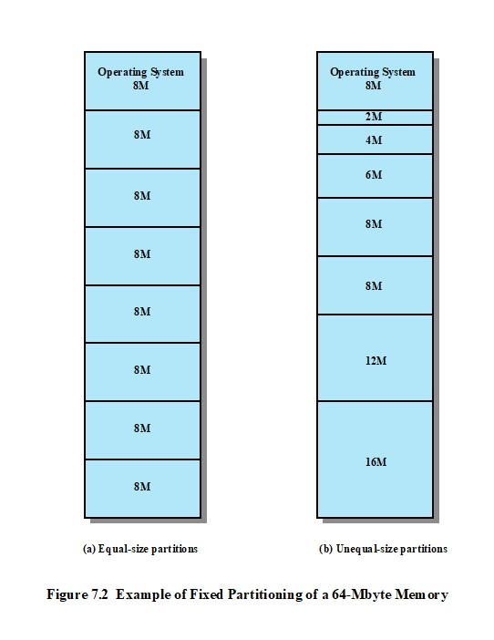
TWO POSSIBILITIES
i) EQUAL SIZE PARTITIONING
ii) UNEQUAL SIZE PARTITIONING

Slide 11
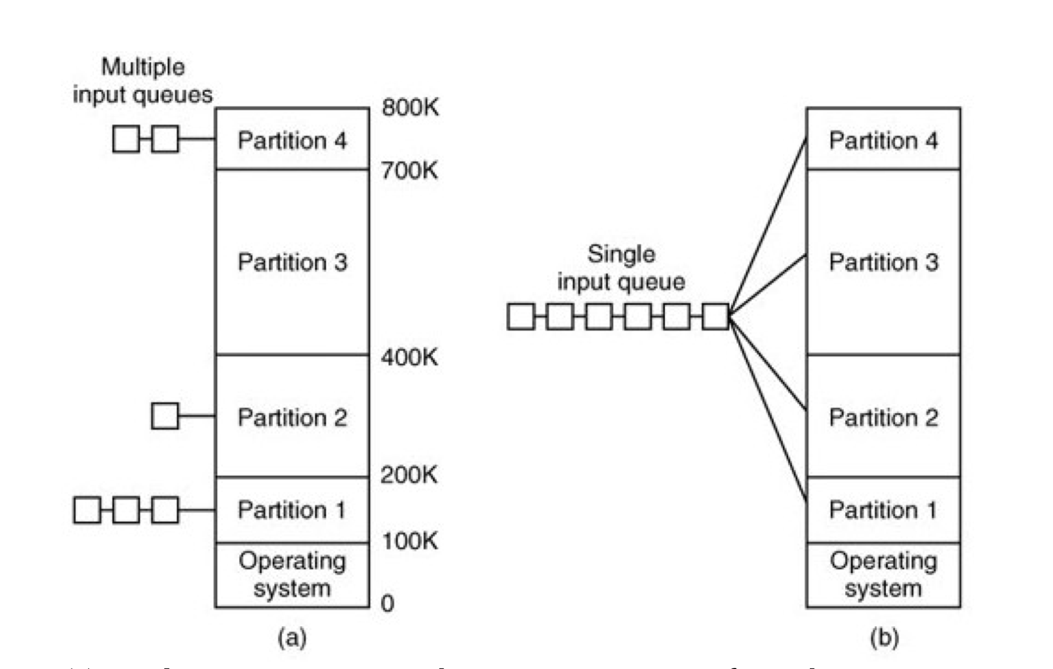
SINGLE VS MULTIPLE INPUT QUEUE

Slide 12
DYNAMIC PARTIONING
It is a part of the Contiguous allocation technique. Initially, RAM is empty and partitions are made during the run-time according to the process’s need instead of partitioning during system configuration.
The size of the partition will be equal to the incoming process.
The partition size varies according to the need of the process so that internal fragmentation can be avoided to ensure efficient utilization of RAM.
The number of partitions in RAM is not fixed and depends on the number of incoming processes and the Main Memory’s size.

Slide 13
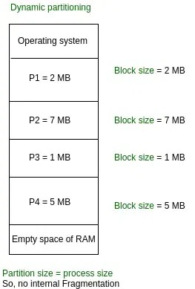

Slide 14
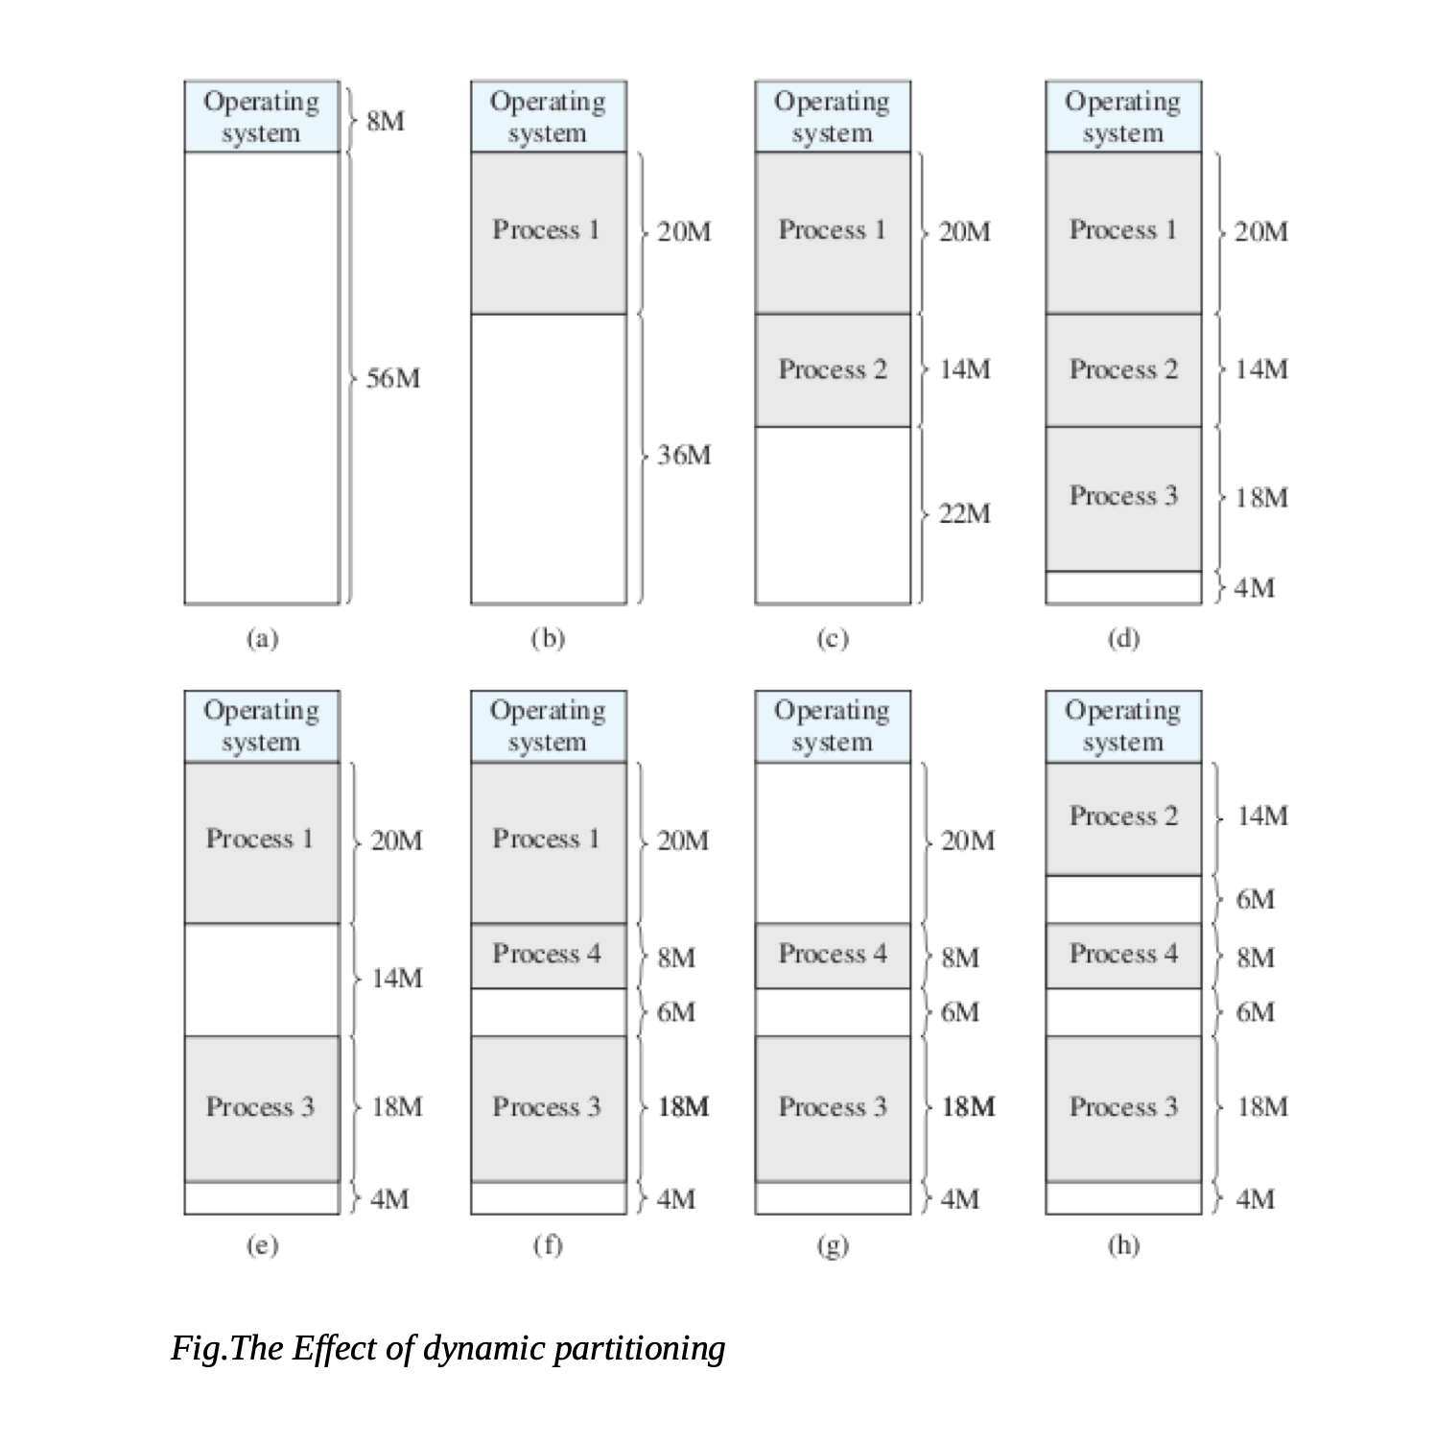

Slide 15
LOADING
STATIC LOADING AND DYNAMIC LOADING
Static Loading involves loading all the necessary program components into the main memory before the program's execution begins. This means that both the executable code and data are loaded into predetermined memory locations. This allocation is fixed and does not change during the program's execution. While it ensures direct access to all required resources, it may lead to inefficiencies in memory usage, especially if the program doesn't utilize all the loaded components.
Dynamic Loading, takes a more flexible approach. In this scheme, a program's components are loaded into the main memory only when they are specifically requested during execution. This results in a more efficient use of memory resources as only the necessary components occupy space. Dynamic loading is particularly advantageous for programs with extensive libraries or functionalities that may not be used in every session.

Slide 16
LINKING
STATIC AND DYNAMIC LINKING
Static Linking involves incorporating all necessary libraries and modules into the final executable at compile time. This means that the code from libraries is copied into the final executable file.
Dynamic Linking, the necessary libraries are not included in the final executable. Instead, the program dynamically links to the required libraries at runtime. This means that multiple programs can share a single copy of a library, reducing redundancy and conserving memory. However, it does introduce a dependency on the availability of the required libraries at runtime.
Example: Consider a scenario where multiple programs use a common math library. With static linking, each program would contain its own copy of the library, potentially leading to larger file sizes. With dynamic linking, all programs can use the same shared instance of the library, saving disk space

Slide 17
PAGING
Paging is a memory management technique in which process address space is broken into blocks of the same size called pages.
In paging, the physical memory is divided into fixed-size blocks called page frames, which are the same size as the pages used by the process. The process’s logical address space is also divided into fixed-size blocks called pages, which are the same size as the page frames.
PAGE SIZE = FRAME SIZE

Slide 18
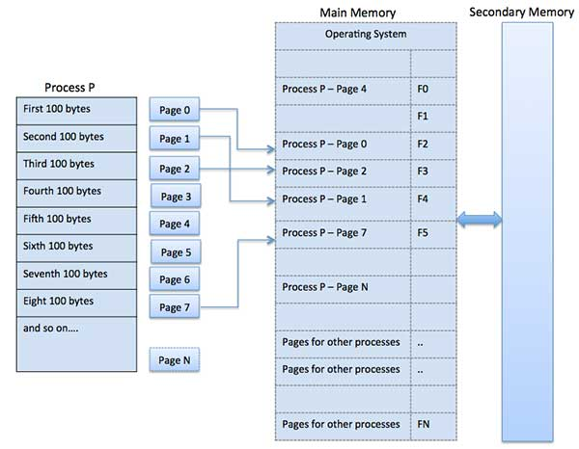
PAGING

Slide 19
ADDRESS TRANSLATION
Page address is called logical address and represented by page number and the offset.
Logical Address = Page number + page offset
Frame address is called physical address and represented by a frame number and the offset.
Physical Address = Frame number + page offset
A data structure called page map table is used to keep track of the relation between a page of a process to a frame in physical memory.

Slide 20
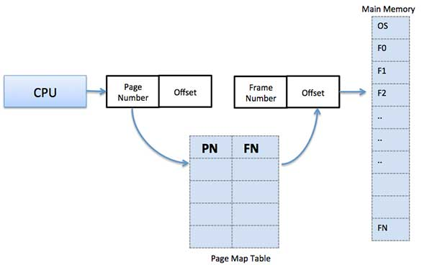
PAGING

Slide 21
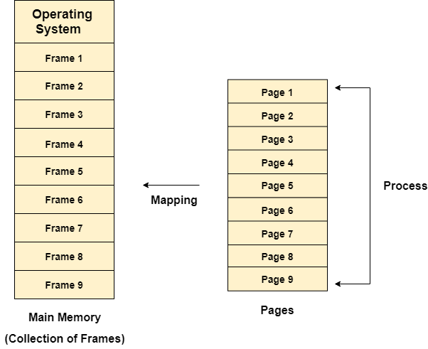
PAGING - CONT.
Paging is a method of gaining access to data more quickly.
When a program requires a page, it is available in the main memory because the OS copies a set number of pages from the storage device into the main memory.
Paging permits a process’s physical address space to be noncontiguous.
Paging refers to a memory management strategy that does away with the need for the allocation of contiguous physical memory.

Slide 22
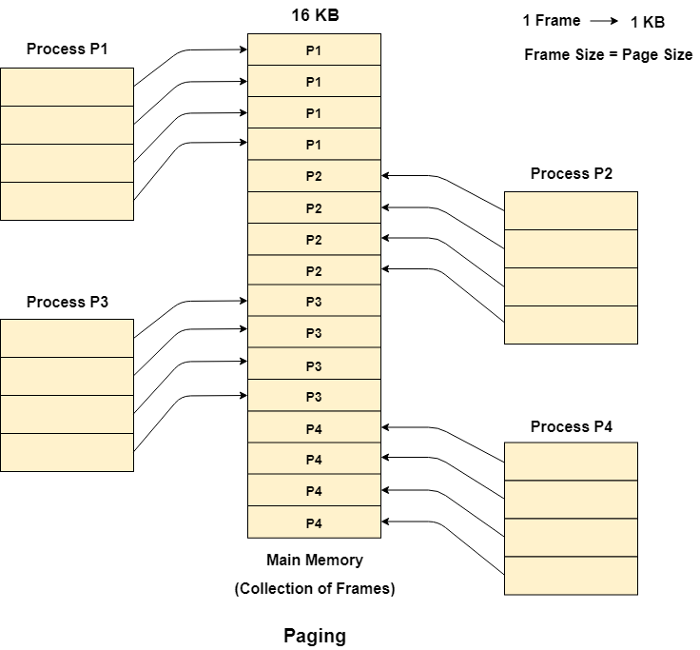
EXAMPLE - PAGING
Let us consider the main memory size 16 Kb and Frame size is 1 KB therefore the main memory will be divided into the collection of 16 frames of 1 KB each.
There are 4 processes in the system that is P1, P2, P3 and P4 of 4 KB each. Each process is divided into pages of 1 KB each so that one page can be stored in one frame.
Initially, all the frames are empty therefore pages of the processes will get stored in the contiguous way.
Frames, pages and the mapping between the two is shown in the image below.

Slide 23
ADVANTAGES & DISADVANTAGES
OF PAGING
Here is a list of advantages and disadvantages of paging −
Paging reduces external fragmentation, but still suffer from internal fragmentation.
Paging is simple to implement and assumed as an efficient memory management technique.
Due to equal size of the pages and frames, swapping becomes very easy.
Page table requires extra memory space, so may not be good for a system having small RAM.

Slide 24
SEGMENTATION
In Operating Systems, Segmentation is a memory management technique in which, the memory is divided into the variable size parts. Each part is known as segment which can be allocated to a process.
The details about each segment are stored in a table called as segment table. Segment table is stored in one (or many) of the segments.
Segment table contains mainly two information about segment:
1. Base: It is the base address of the segment
2. Limit: It is the length of the segment.

Slide 25
WHY SEGMENTATION IS REQUIRED ?
Till now, we were using Paging as our main memory management technique. Paging is more
close to Operating system rather than the User. It divides all the process into the form of pages
regardless of the fact that a process can have some relative parts of functions which needs to be
loaded in the same page.
Operating system doesn't care about the User's view of the process. It may divide the same
function into different pages and those pages may or may not be loaded at the same time into the
memory. It decreases the efficiency of the system.
It is better to have segmentation which divides the process into the segments. Each segment
contain same type of functions such as main function can be included in one segment and the
library functions can be included in the other segment,

Slide 26
SEGMENTATION - CONT.
Translation of Logical address into physical address by segment table
CPU generates a logical address which contains two parts:
1. Segment Number
2. Offset - the distance or displacement from a reference point
The Segment number is mapped to the segment table. The limit of the respective segment is
compared with the offset. If the offset is less than the limit then the address is valid otherwise it
throws an error as the address is invalid.
In the case of valid address, the base address of the segment is added to the offset to get the
physical address of actual word in the main memory.

Slide 27
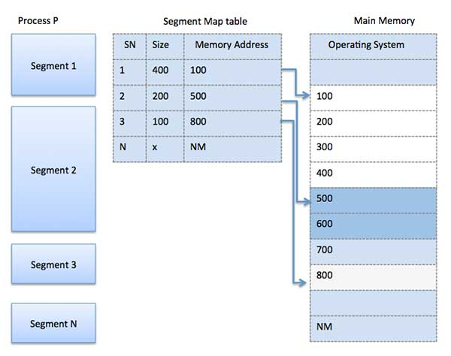
SEGMENTATION

Slide 28
ADVANTAGES & DISADVANTAGES
OF SEGMENTATION
Advantages of Segmentation
1. No internal fragmentation
2. Average Segment Size is larger than the actual page size.
3. Less overhead
4. It is easier to relocate segments than entire address space.
5. The segment table is of lesser size as compare to the page table in paging.
Disadvantages
1. It can have external fragmentation.
2. it is difficult to allocate contiguous memory to variable sized partition.
3. Costly memory management algorithms.

Slide 29
VIRTUAL MEMORY
HARDWARE AND CONTROL STRUCTURES
Virtual Memory is a storage allocation scheme in which secondary memory can be addressed as though it were part of the main memory.
It is a technique that is implemented using both hardware and software. It maps memory addresses used by a program, called virtual addresses, into physical addresses in computer memory.
1.All memory references within a process are logical addresses that are dynamically translated into physical addresses at run time. This means that a process can be swapped in and out of the main memory such that it occupies different places in the main memory at different times during the course of execution.
2.A process may be broken into a number of pieces and these pieces need not be continuously located in the main memory during execution. The combination of dynamic run-time address translation and the use of a page or segment table permits this.

Slide 30
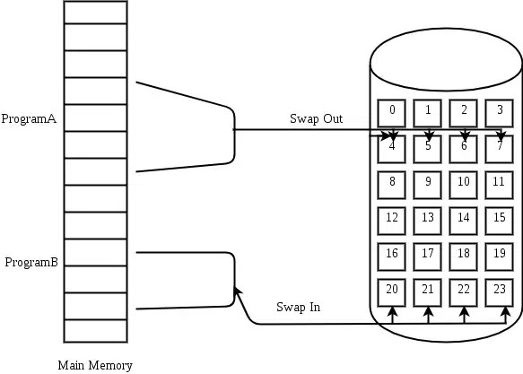
SWAPPING
Swapping is a technique used in operating systems to manage memory more efficiently, especially when the physical memory (RAM) becomes full. When a system runs out of available physical memory, and additional memory is needed to execute a process or to accommodate new data, the operating system can use swapping to temporarily transfer some data from RAM to secondary storage (usually a hard disk or SSD), thereby freeing up space in the physical memory.
It is a process out means removing all of its pages from memory, or marking them so that they will be removed by the normal page replacement process. Suspending a process ensures that it is not runnable while it is swapped out. At some later time, the system swaps back the process from the secondary storage to the main memory. When a process is busy swapping pages in and out then this situation is called thrashing.

Slide 31
VIRTUAL MEMORY MANAGEMENT POLICY
Fetch policy
Placement policy
Replacement policy
Resident set Management
Cleaning policy
Load Control

